Slide 1
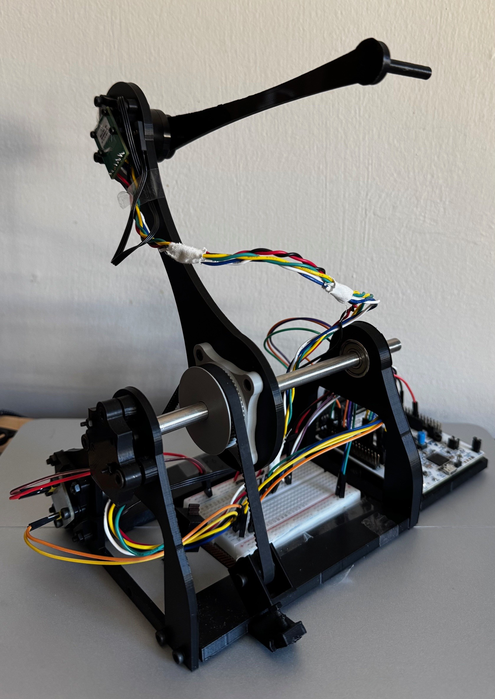
A Low-Cost Real-Time Haptic Rendering System with Physics-Based Simulation and Force Feedback
Low-cost physical haptic device
Real-time simulation and visualisation
Bidirectional force-feedback loop

Slide 2
Why Haptic Feedback for Robotic Training?
Visual feedback only | Visual + haptic feedback
See motion/contact | Feel resistance/contact
Limited force awareness | Physical contact cue
Safer than real robot testing | More realistic training
Manipulator training often relies heavily on vision
Contact and force are difficult to communicate visually
Simulation allows safe and low-risk training
Commercial haptic devices are expensive

Slide 3
The Challenge
User
Device Sensors
MCU
Host Simulation
Haptic Engine
Torque Command
Motors
Real-time bidirectional interaction.
Motion must be sensed and transmitted.
Contact force must be computed and returned.
Delay, actuator limits, and safety affect fidelity.

Slide 4
Aim and Evaluation Questions
Aim:
Design, prototype, and evaluate a low-cost haptic interface for simulated robotic manipulation.
Evaluation questions:
Can the system operate around 1 kHz?
Does the force model produce predictable bounded contact?
What limits achievable haptic fidelity?

Slide 5
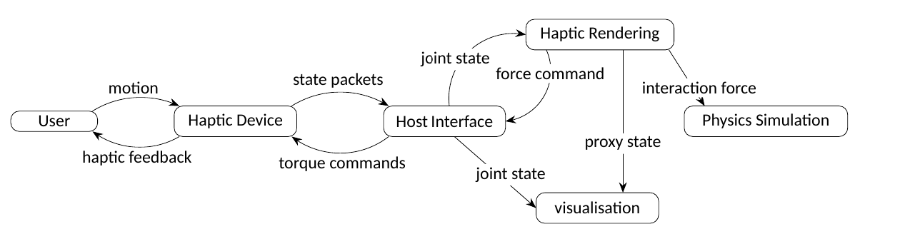
System Architecture

Slide 6
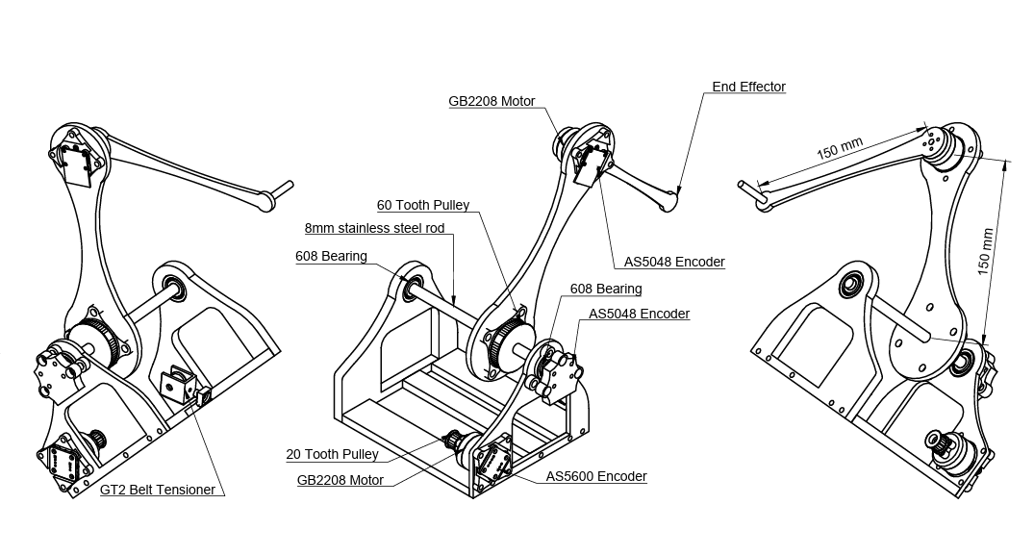
Physical Haptic Device and Embedded Control
2-DOF planar serial mechanism.
BLDC gimbal motors.
3:1 GT2 Pulley reducer
Magnetic encoder position sensing.
STM32 embedded control.
Torque clamp, slew-rate limiter, watchdog.

Slide 7
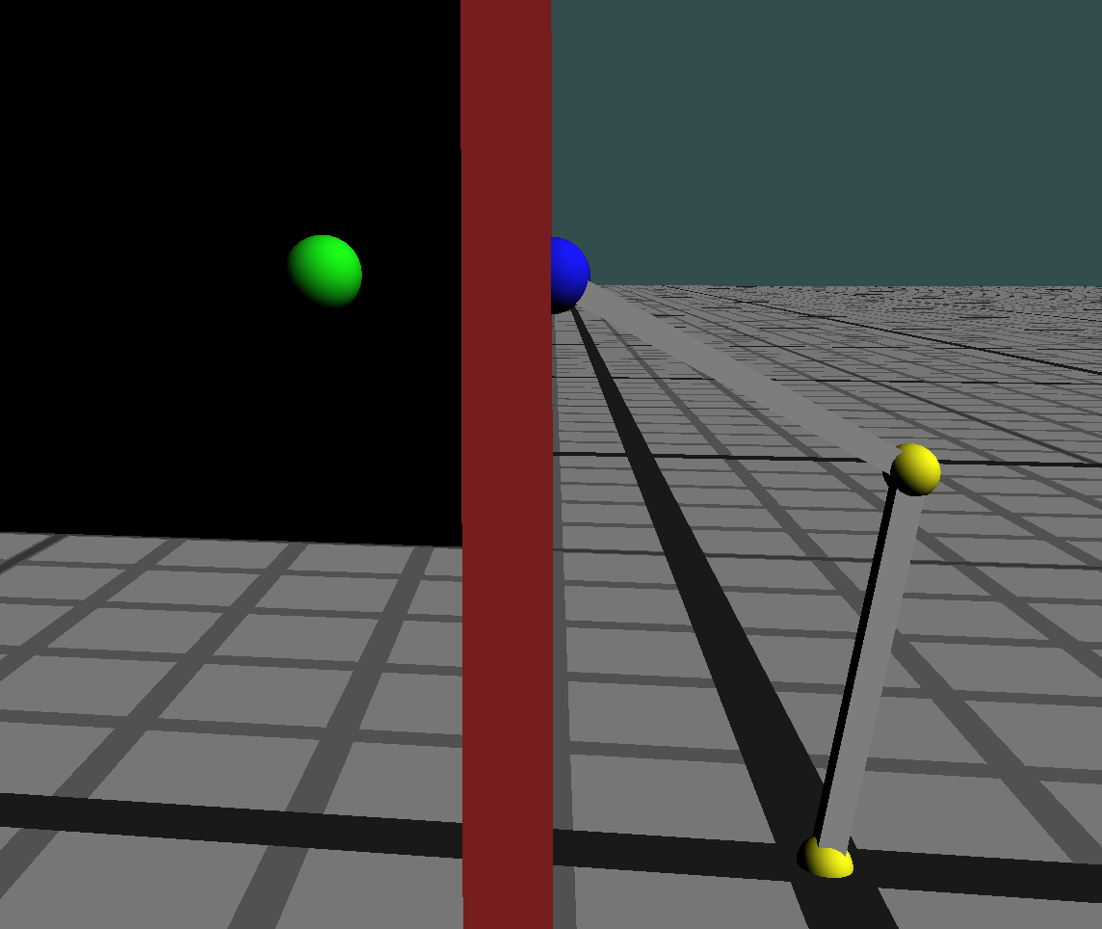



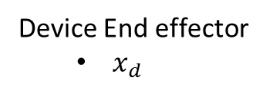
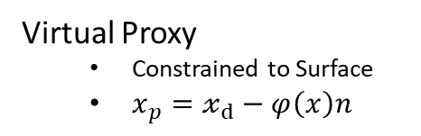
From Virtual Contact to Motor Torque
Virtual Wall
Device End effector
$x_{d}$
Virtual Proxy
Constrained to Surface
$x_{p}=𝓍_{d}−φ\left(x\right)n$
$$F = K(x_{p}−x_{d}) + D(v_{p}−v_{d})$$
$$τ = J^{T} F$$

Slide 8
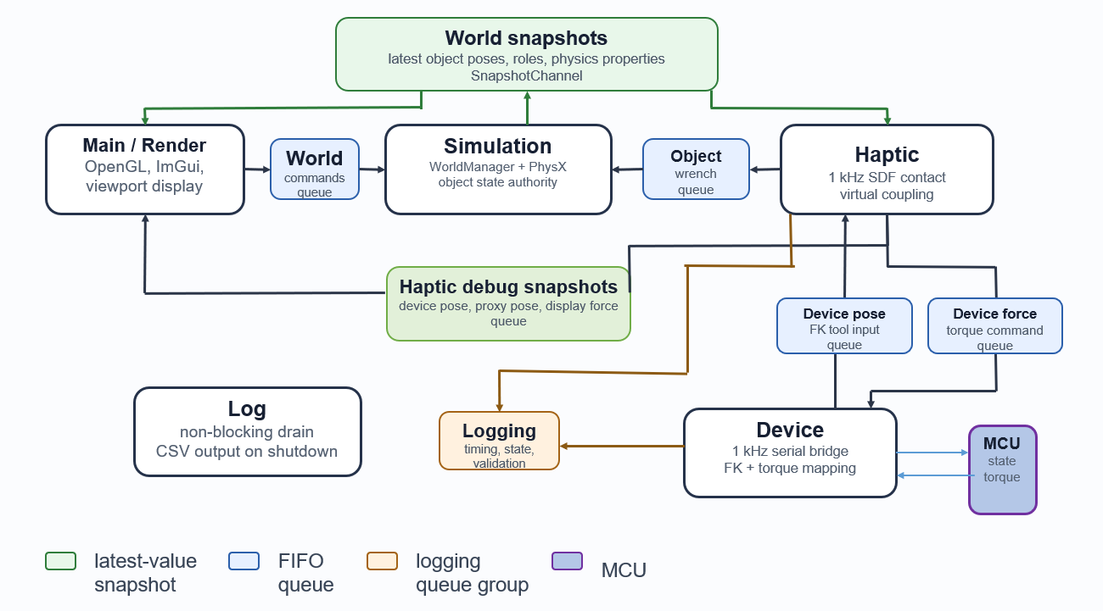
Host Software

Slide 9
Demonstration

Slide 10
Key Results
Area | Result | Interpretation
Update rate | ~1KHz | Real-time loop achieved
Host Latency | 0.299 ms mean | Host computation not bottleneck
RTT | 15.60–15.67 ms | Communication dominates
Force model | 489.57 N/m, R² = 0.9973 | Matches 500 N/m target
Safety | 31 N clamp, 55 N m/s slew limit | Bounded interaction

Slide 11
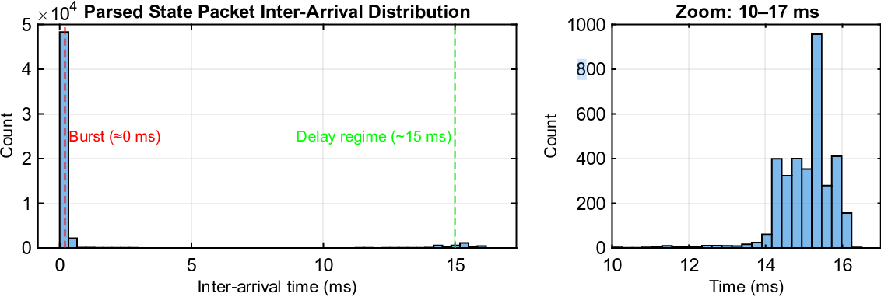
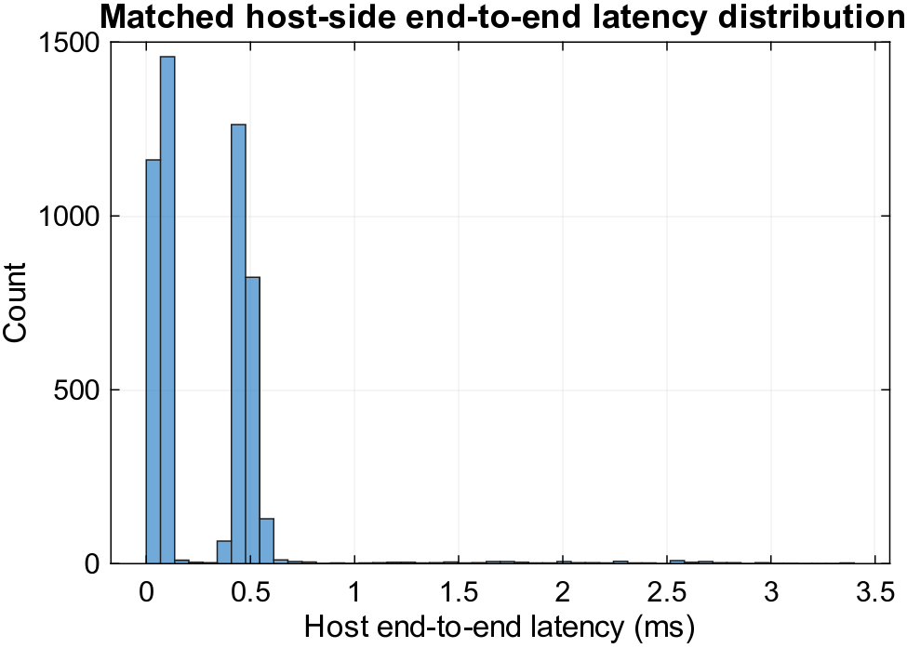
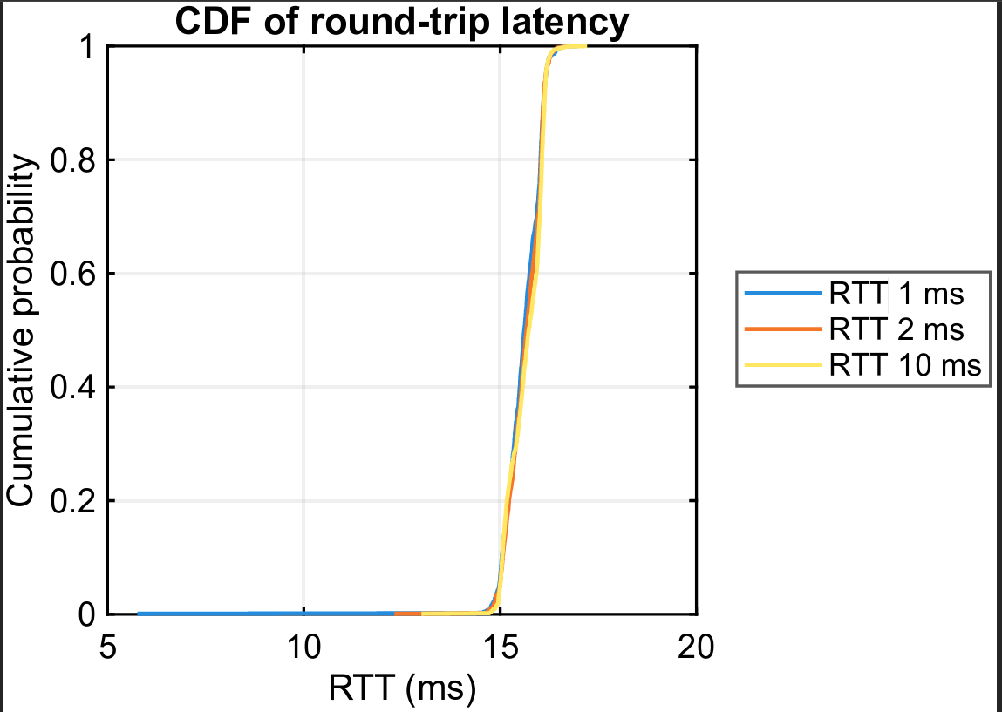
Main Bottleneck: Communication Latency
Host computation was fast; transport delay dominated the haptic loop.

Slide 12
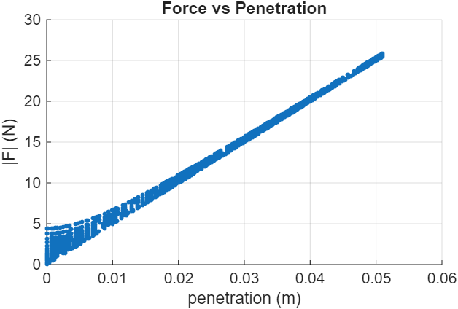
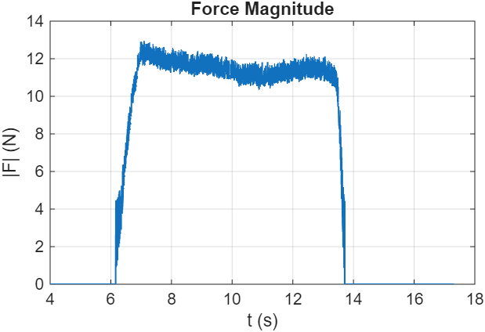
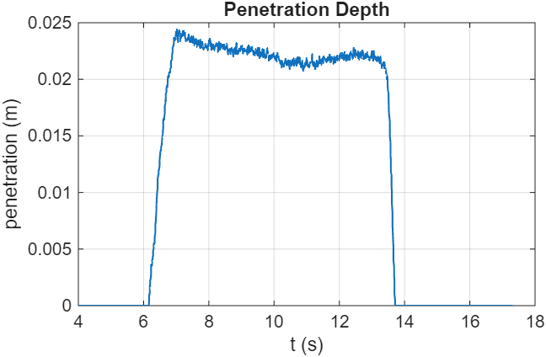
Haptic Rendering Validation
Motors disabled to isolate command-side force model.
Configured stiffness: 500 N/m.
Fitted stiffness: 489.57 N/m.
R² = 0.9973.
Single-depth contact remained stable: coefficient of variation = 0.026.

Slide 13
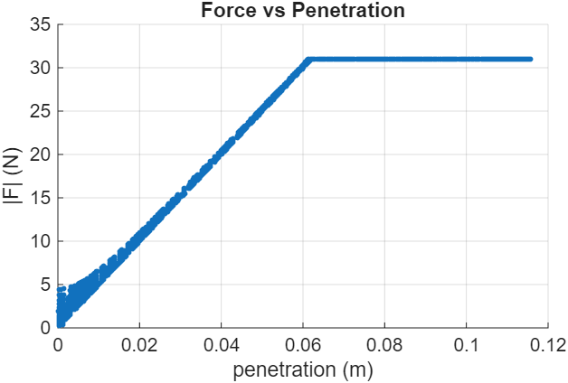
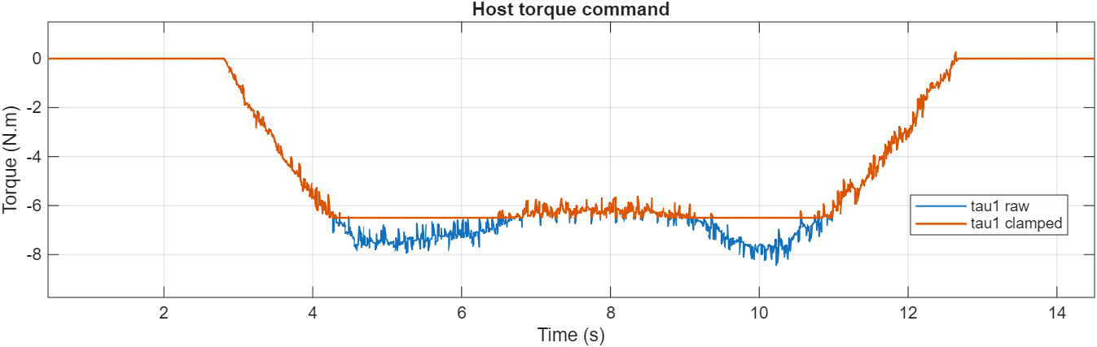
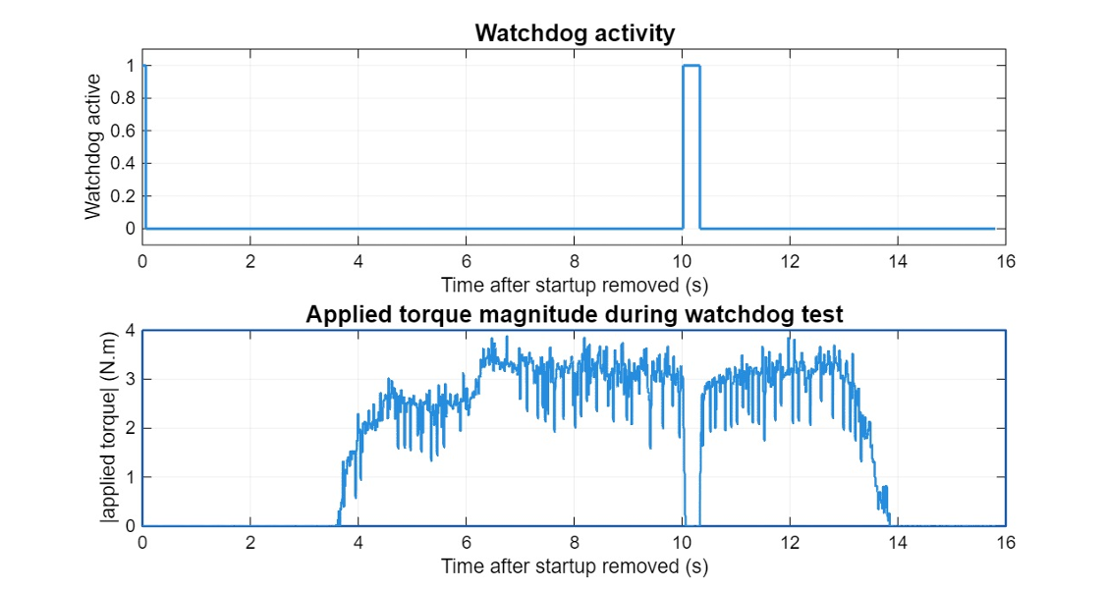
Safety Validation
Host force command saturated at 31 N.
Firmware torque cap limited applied command.
Slew-rate limiter bounded sudden torque changes.
Watchdog set torque to zero during communication loss.

Slide 14
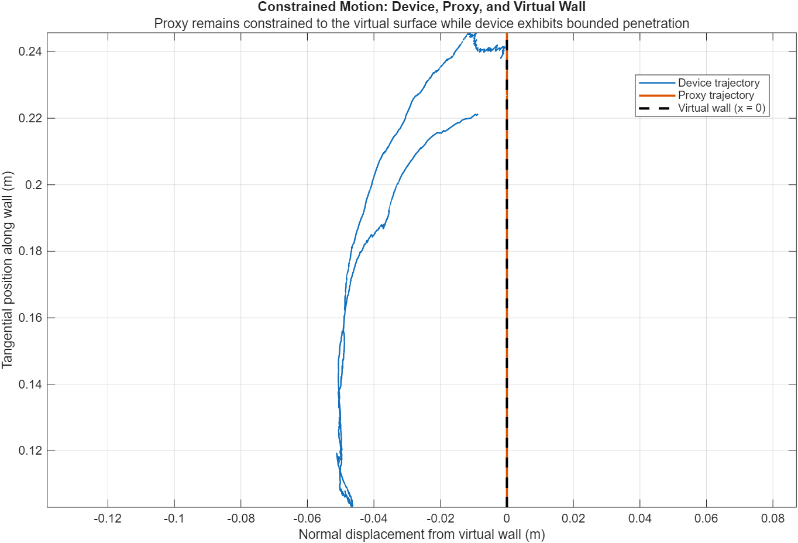
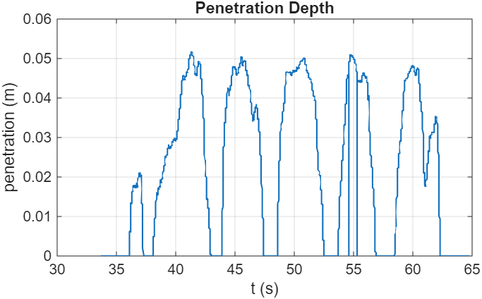
Hardware Validation
Motor-enabled contact produced clear resisting feedback.
Contact penetration remained bounded under normal interaction.
Surface-following motion showed constraint behaviour.
Response was not rigid due to latency, slew-rate limiting, and belt compliance.
Belt slip occurred under higher user force.

Slide 15
Design Trade-Offs and Limitations
15–16 ms RTT limited stable virtual stiffness.
No current sensing limited force calibration.
Belt stage introduced compliance/slip.
Damping improved stability but softened contact.
Slew-rate limiting reduced oscillation but slowed force response.

Slide 16
CPD and Project Management
CPD
OpenGL rendering.
C++ real-time architecture.
BLDC motor control.
Haptic rendering theory.
Latency analysis.
Project adaptation
Driver integration issues.
Pivot to SimpleFOC Mini.
Hardware delays.
Actuator failure.
Integrated testing.

Slide 17
Conclusions
Complete low-cost haptic loop built and evaluated.
Achieved real-time sensing, rendering, torque command generation, and physical feedback.
Command-side force model matched intended stiffness.
Physical interaction was bounded and usable, but not rigid or force-calibrated.
Communication latency was the dominant limitation.
Haptic fidelity depends on the whole closed-loop system.
High-rate control alone is not enough: latency, actuation, transmission, and control design jointly determine haptic fidelity.

Slide 18
Future Work
Lower-latency communication link.
Current sensing and force measurement.
Restore full 2-DOF actuation.
Improve transmission design.
Improve proxy/contact handling.
More realistic simulator integration.
User/task-based evaluation.

Slide 19
Questions?

